Slide 1
Heart Disease Prediction and Patient Segmentation Using Machine Learning
• UCI Heart Disease Dataset
• Supervised and Unsupervised Learning
• Explainability and Responsible AI Analysis
Henry Escalante
Date: October 8, 2026

Slide 2
Business Problem & Objective
Business Problem
If identifiable groups are present, they may provide useful insights for future research on preventive care programs, monitoring approaches, and resource allocation.
Core Objective
Investigate whether machine learning can:
  Predict heart disease status from clinical variables.
  Identify distinct patient groupings using unsupervised learning techniques.
  Understand which clinical factors most strongly influence model predictions.
Research Questions
? Which model provides the strongest predictive performance?
? Do meaningful, clinically relevant patient clusters exist within the data?
? Which clinical variables contribute most to predictions?

Slide 3
Dataset Overview: UCI Heart Disease
Clinical Variables (Features)
• Age & Sex
• Chest Pain Type (cp)
• Cholesterol & Resting Blood Pressure
• Maximum Heart Rate (thalach)
• ST Depression (oldpeak)
• Number of Major Vessels (ca)
• Thalassemia Result (thal)
Target Class
Binary Prediction Target:
  • Heart Disease present
  • No Heart Disease (Healthy)
Methodology & Pipeline
Supervised Models
• Logistic Regression
• Decision Tree
• Random Forest
• XGBoost
• SVM (RBF)
Unsupervised Models
• K-Means
• Hierarchical Clustering
• DBSCAN
Evaluation Metrics
Supervised:
  - Accuracy
  - ROC-AUC
  - F1 Score
Unsupervised:
  - Hopkins Statistic
  - Silhouette Score
GitHub: https://github.com/eschenry/Heart-Disease-ML.git

Slide 4
Supervised Model Results
Model | Accuracy | ROC-AUC | F1 Score
Random Forest | 0.934 | 0.963 | 0.931
XGBoost | 0.902 | 0.947 | 0.897
SVM | 0.885 | 0.951 | 0.873
Logistic Regression | 0.852 | 0.958 | 0.847
Decision Tree | 0.721 | 0.723 | 0.712
⭐ Key Observation:
Random Forest achieved the strongest overall performance across all evaluation metrics, indicating its high resilience and capability on this clinical structure.
Hyperparameter Tuning Impact
Random Forest Tuning
✔ Accuracy: 0.918 → 0.934
✔ ROC-AUC: 0.958 → 0.963
✔ F1: 0.915 → 0.931
SVM Tuning
✔ Accuracy: 0.689 → 0.885
✔ F1: 0.578 → 0.873
Observation:
The largest relative performance improvement was observed in the SVM after systematic hyperparameter tuning.

Slide 5
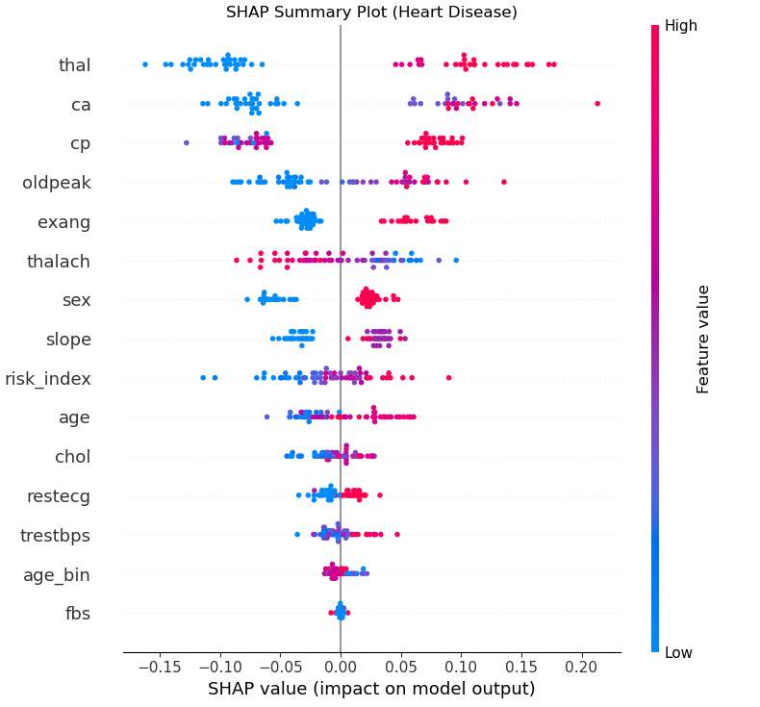
Model Explainability & Feature Importance
Methods Used
• Random Forest Global Feature Importance
• SHAP (SHapley Additive exPlanations)
Top Global Predictors
• thal (Thalassemia Result)
• ca (Number of Major Vessels)
• cp (Chest Pain Type)
• oldpeak (ST Depression)
• thalach (Max Heart Rate)
Key Finding: Feature rankings were broadly consistent across SHAP values and RF internal importance metrics.
[ Insert SHAP Summary Plot Here ]

Slide 6
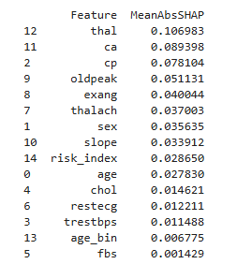
Clinical Interpretation of SHAP Values
[ Insert SHAP Summary Figure Here ]
Clinical Associations
Higher risk predictions were commonly associated with:
  • Increased oldpeak (ST depression during exercise)
  • Abnormal thal (thalassemia) results
  • More affected major vessels (ca)
  • Lower maximum heart rate achieved (thalach)
⚠️ Critical Warning:
SHAP values explain statistical associations built by the machine learning model, not physiological causation.

Slide 7
Patient Segmentation (Unsupervised)
Method | Optimum Clusters Found | Silhouette Score
K-Means | 2 | 0.546
Hierarchical Clustering | 2 | 0.540
DBSCAN | No Valid Solution | N/A
Core Finding:
Moderate cluster structures exist when evaluating silhouette scores; however, cluster separation remains limited. DBSCAN failed to isolate valid density groupings, confirming that boundaries are soft.

Slide 8
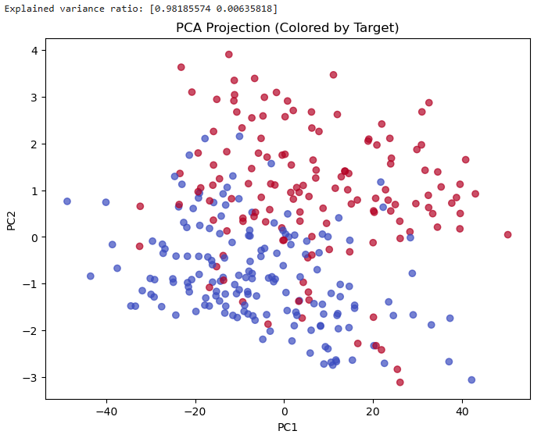
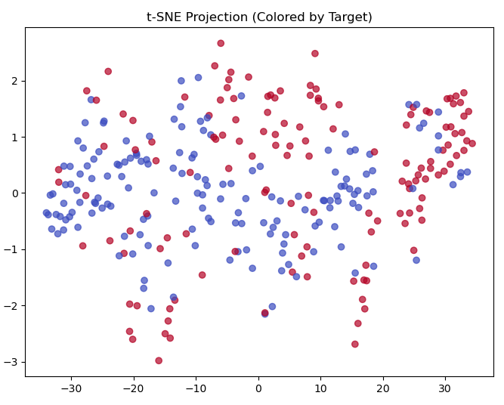
Dimensionality Reduction & Visualization
[ Insert PCA Visualization Here ]
[ Insert t-SNE Visualization Here ]
Observation: Some grouping tendency is visually apparent, but substantial overlapping indicates lack of strict separation between patient cohorts.

Slide 9
Key Technical Limitations
Dataset Limitations
• Relatively small public repository scale
• Lack of structural & clinical demographic diversity
• No external clinical cohort validation
Fairness & Data Gaps
• Race and geographic details are missing
• Socioeconomic variables not available
• Algorithmic fairness metrics were not formally computed
Crucial Implication:
Results must strictly be interpreted as exploratory clinical findings, not ready for deploying as medical diagnostic decisions.

Slide 10
Business Problem Assessment
Was the business objective achieved?
Answer: PARTIALLY
Findings indicate:
  • Some weak-to-moderate data clustering tendencies exist inside the clinical features.
  • Exactly two patient groupings were successfully identified and visualised.
  • The operational separation boundary between these groups is highly moderate.
Therefore:
  These patient clusters should strictly be managed as exploratory cohorts, rather than definitive clinical risk subcategories.

Slide 11
Data Science Problem Assessment
Empirical Evidence
• Hopkins Statistic = 0.681 (indicates clustering tendencies exist but are not extreme)
• K-Means Silhouette Score = 0.546
• Hierarchical Silhouette Score = 0.540
• Significant overlap observed on 2D projection plots (PCA & t-SNE)
Scientific Interpretation
The analysis verifies that the UCI patient cohort possesses moderate cluster signals.
However, it lack strongly separated boundaries. Attempting to create concrete diagnoses purely based on unsupervised clustering will yield highly erroneous overlaps.

Slide 12
Conclusion & Next Steps
Key Findings Summary
• Random Forest models achieved the most robust performance predicting diagnostic target status.
• SHAP frameworks identified clinically consistent predictors (thal, ca, oldpeak).
• K-Means and Hierarchical Clustering models categorized two patient segments.
• Fairness analysis remains incomplete due to public data gaps.
Overall Conclusion
Machine learning models successfully identified clinical patterns linked to heart disease within the UCI dataset.
Nevertheless, due to dataset constraints, all outcomes must be deemed exploratory and will require external clinical validation protocols before hospital-level integration.

